Slide 1
Status meeting

Slide 2
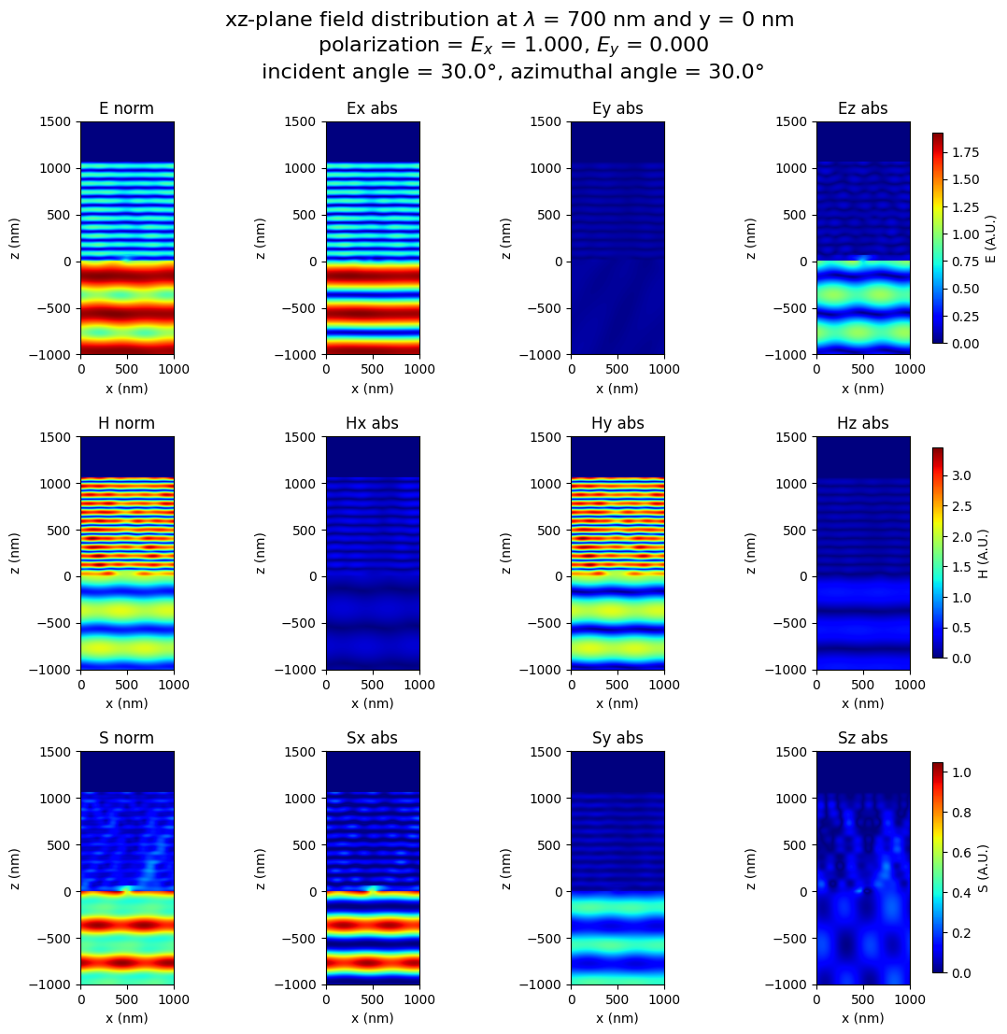
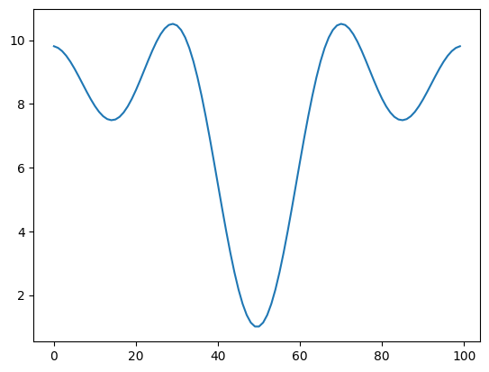
1 layer
0.2 sec

Slide 3
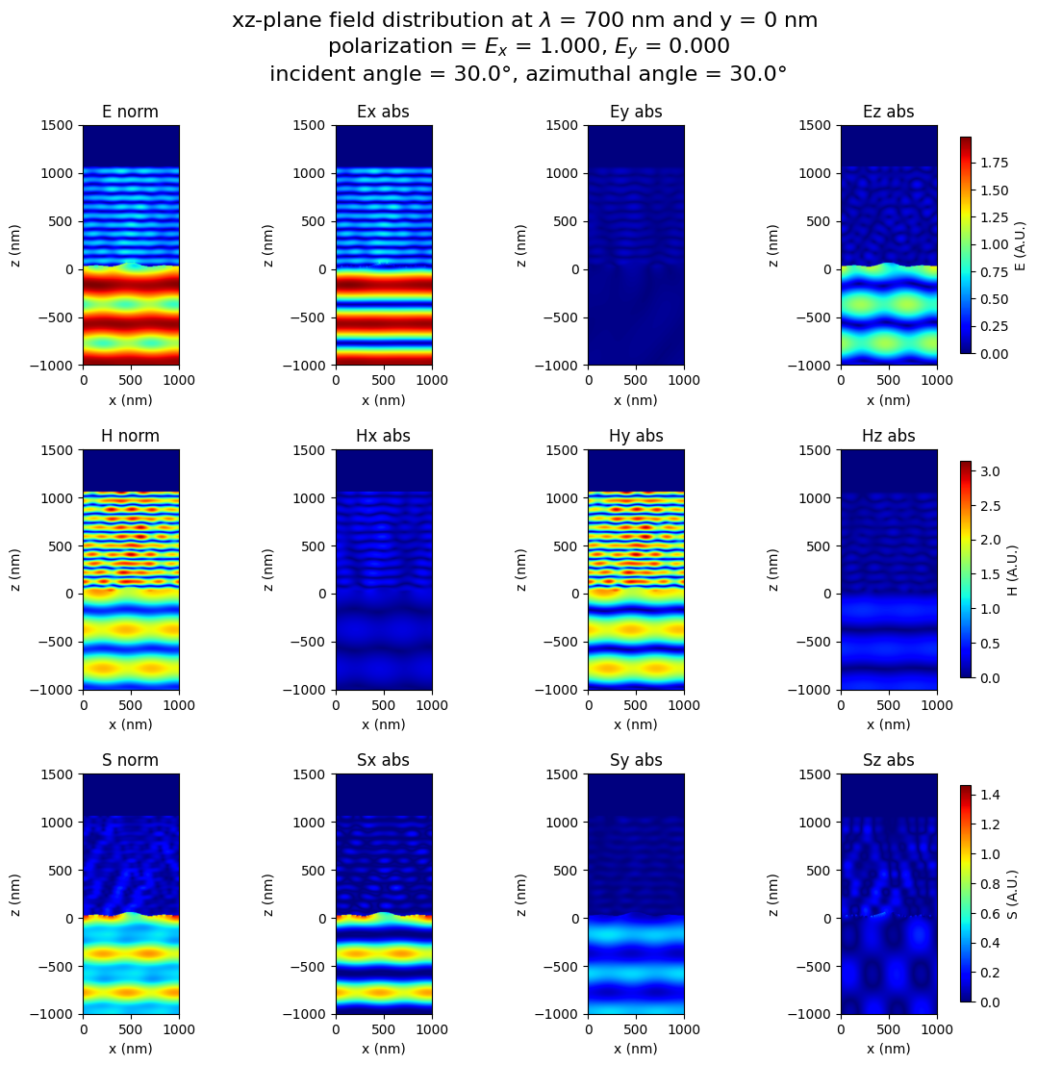
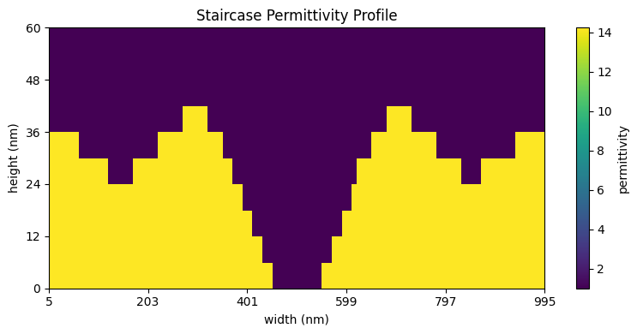
10
layers
0.5 sec

Slide 4

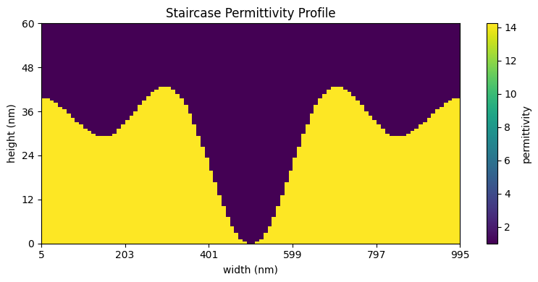
100
layers
2.9 sec

Slide 5


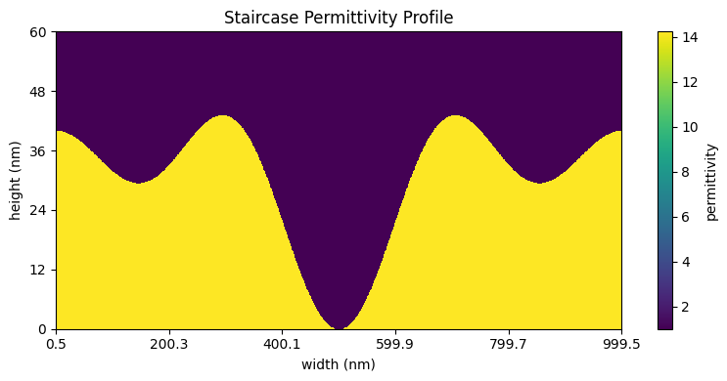
1000
layers
69 sec

Slide 6
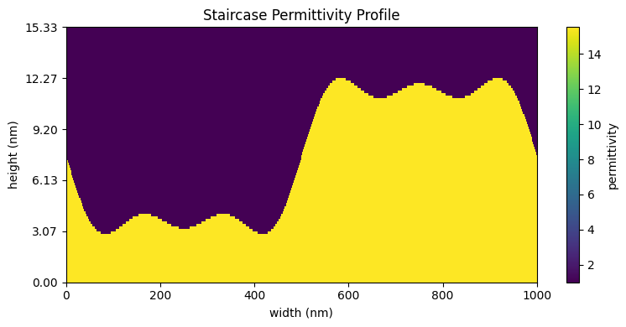

Slide 7
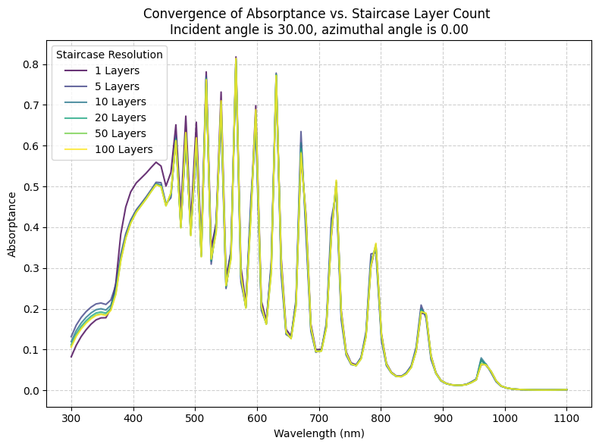

Slide 8
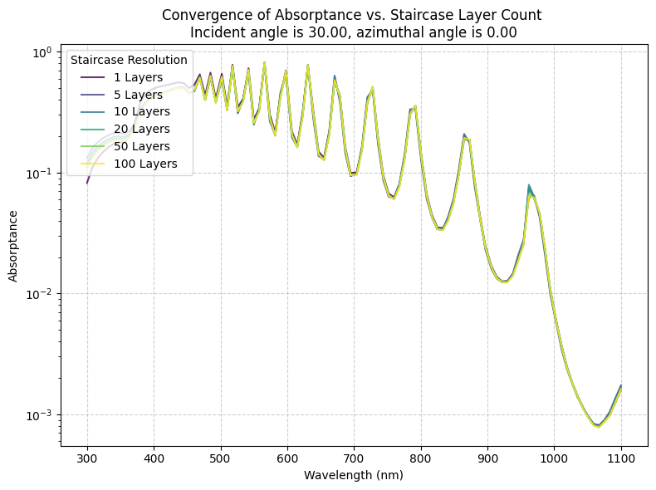

Slide 9
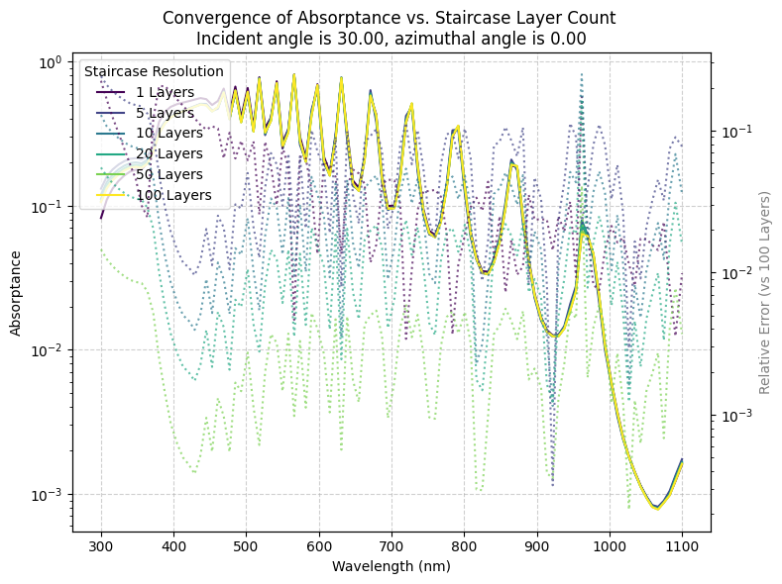

Slide 10
09-04

Slide 11
Comsol results
1 Structure, simple sine wave
Runtime for wavelength sweep was 4 minutes 25 seconds
Takes up much more storage space (1 gb?)

Slide 12
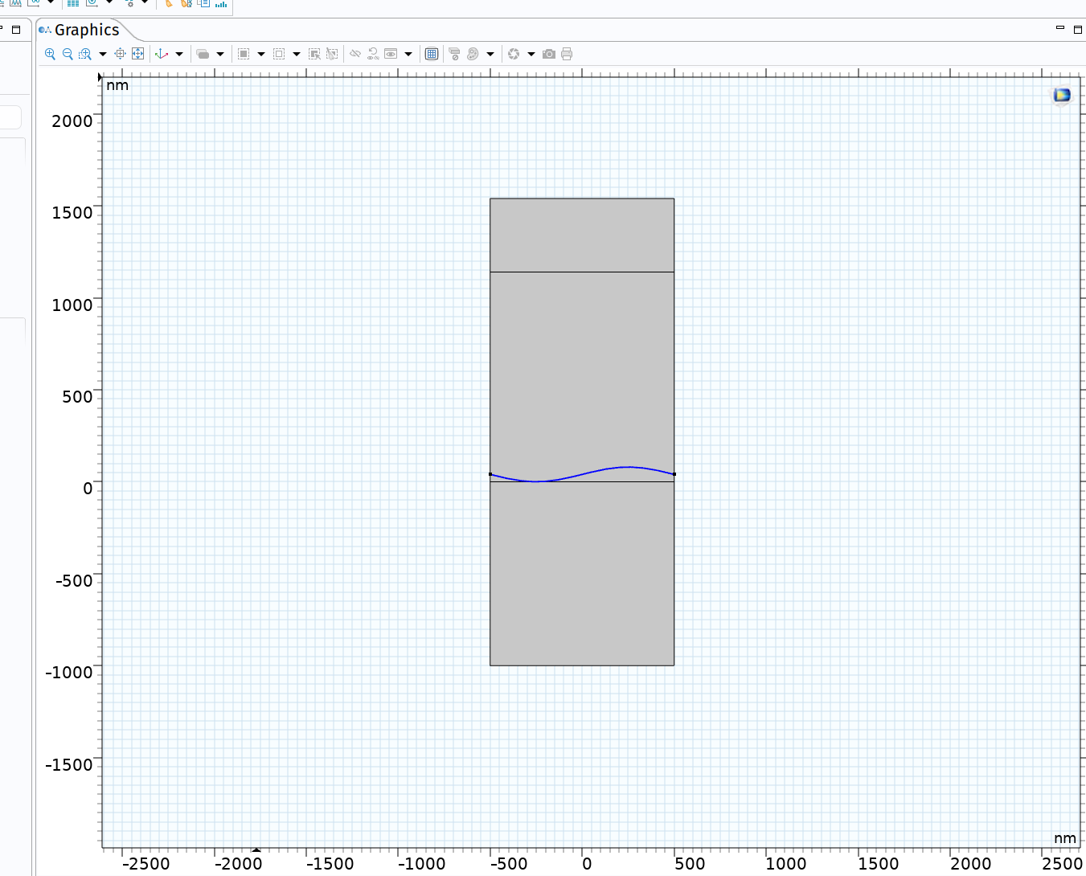

Slide 13
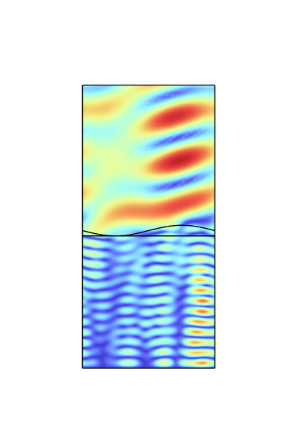
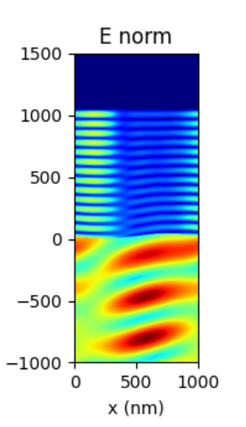

Slide 14
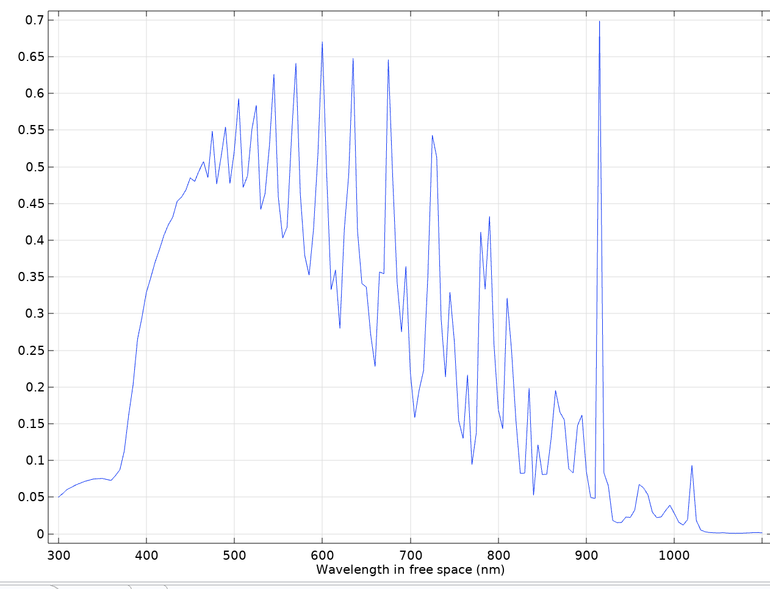
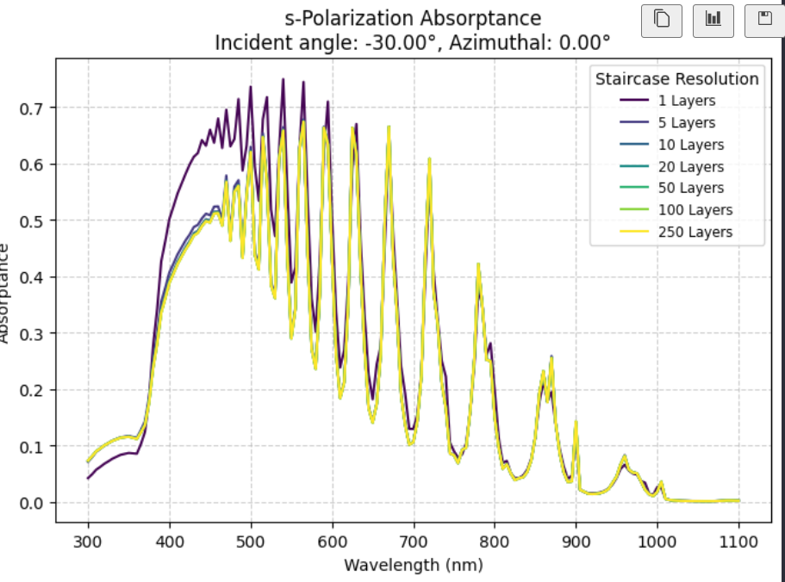

Slide 15
22/04

Slide 16
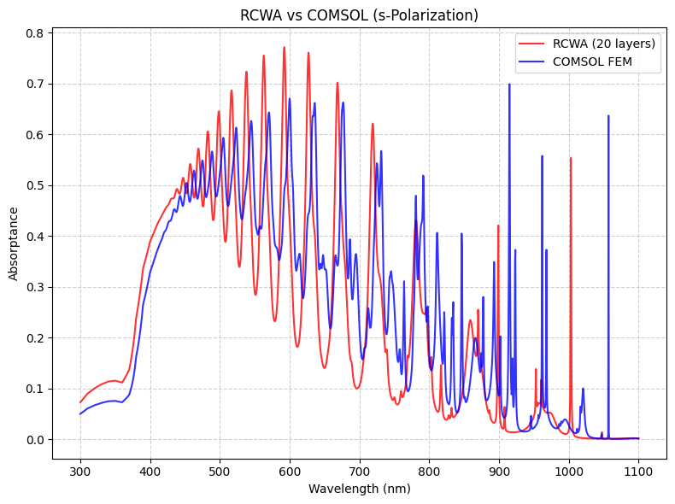

Slide 17

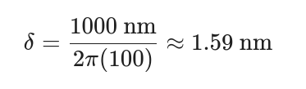
Likely the PEC!
Skin depth of estimated
pec is
so total
PEC of comsol has perfect pi
phase shift, whereas RCWA has non-zero
skin depth penetration in structure

Slide 18
Redid the model with explicit reflector block in Comsol, with same artifical permitivity
This will ensure that resonant conditions at least are equivalent across simulation methods,
Also better naturally extends to real material reflectors
like silver
And I get to remake the model in the same z-direction :)

Slide 19
Remade model with Impedance boundary conditions
Results still did not work :(

Slide 20
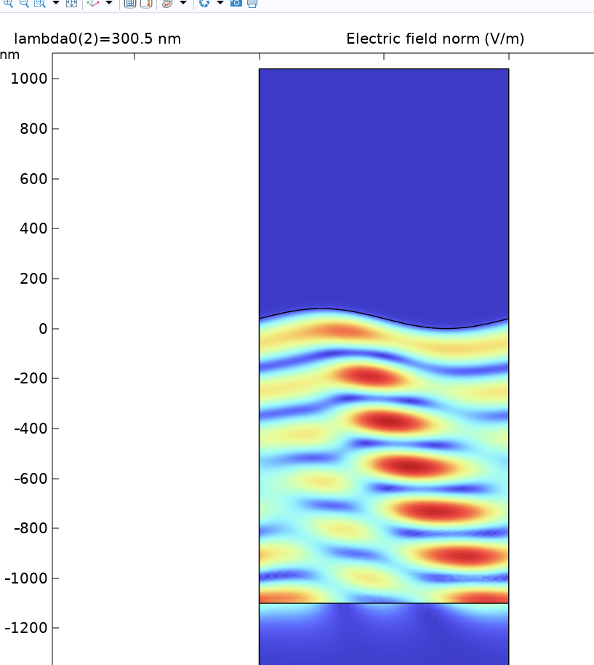
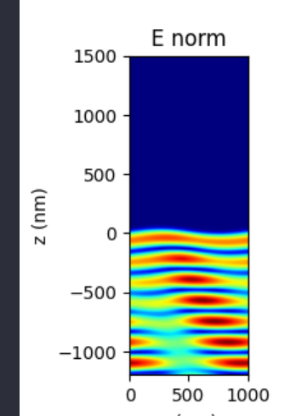

Slide 21
Was really confused, until i found a factor 2 error in my RCWA code. Annoying, but now results coincide!

Slide 22
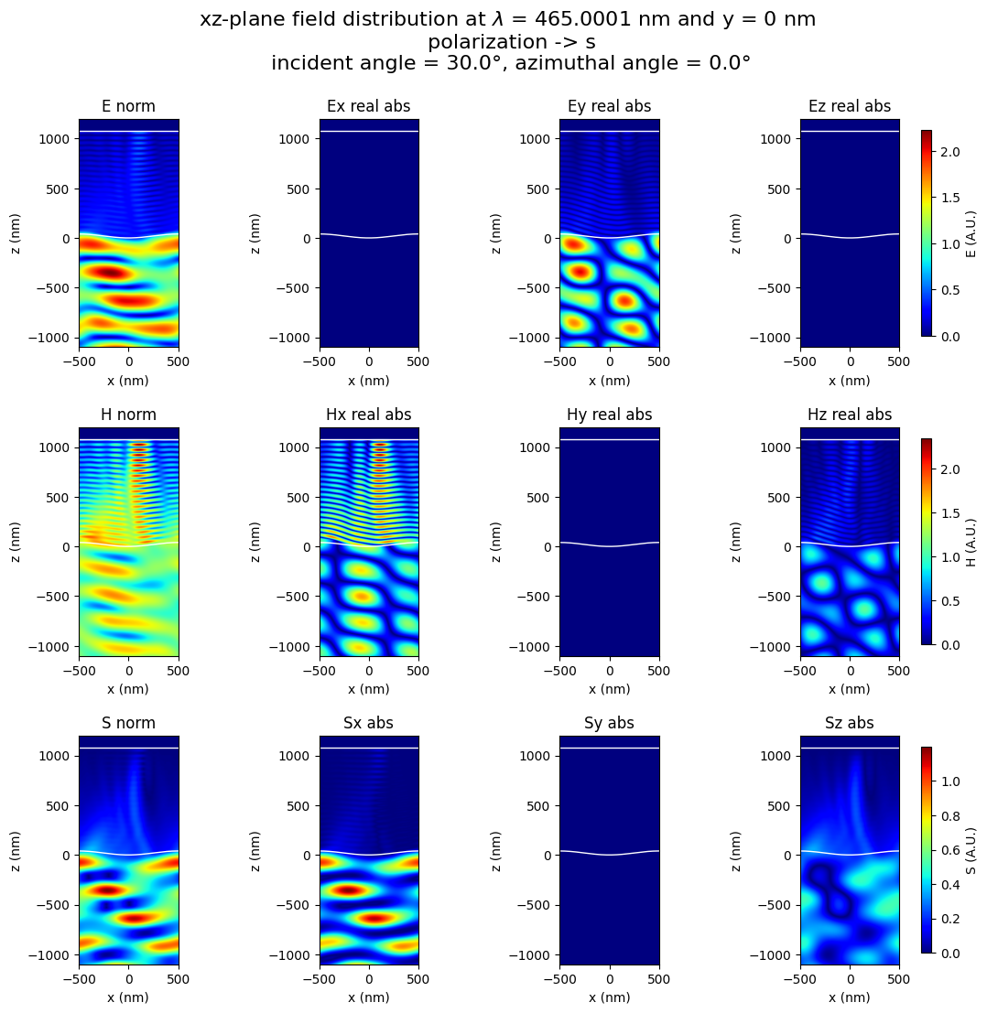

Slide 23
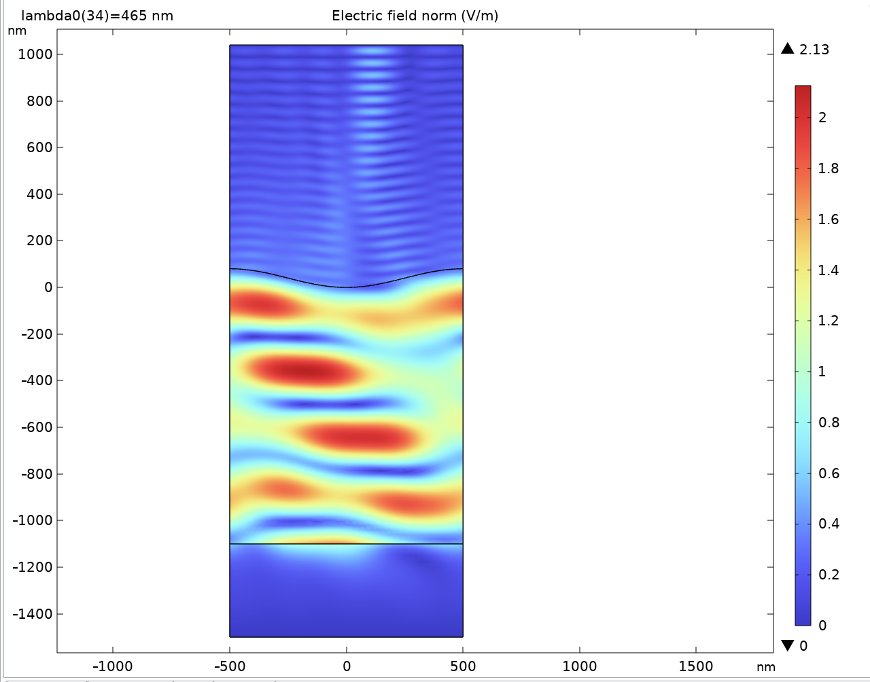
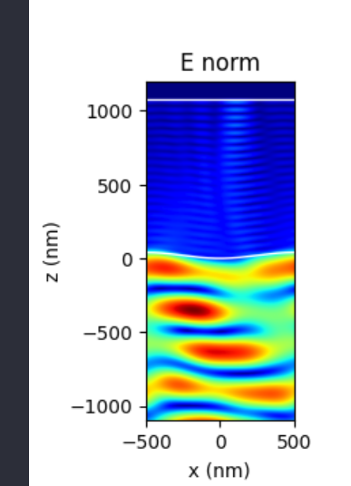


Slide 24
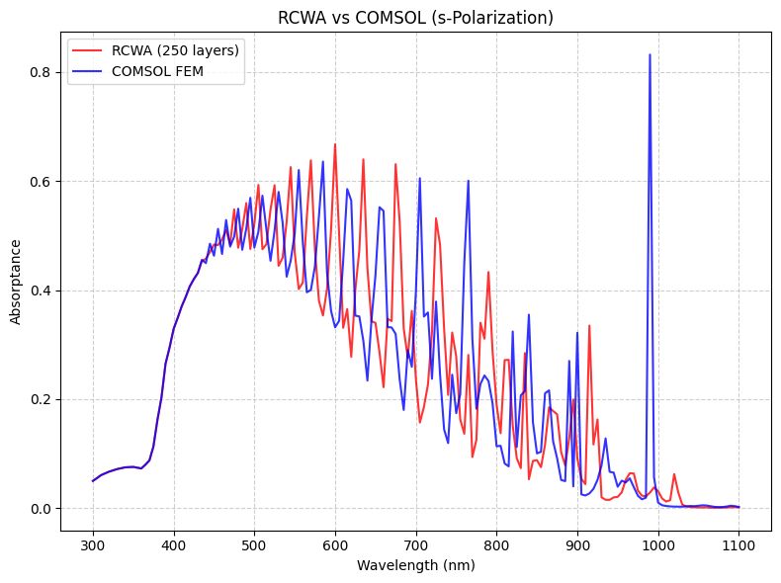

Slide 25
Now looks like RCWA has a slight redshift.
One more sanity check, calculate dissipated heat in same way with RCWA as comsol.

Slide 26
Small resonances might lead to larger divergences in comsol.

Slide 27
Next stop
Data generation, to get schedule back on track
Code already (almost) works for 3d
3d convergence tests in RCWA only

Slide 28
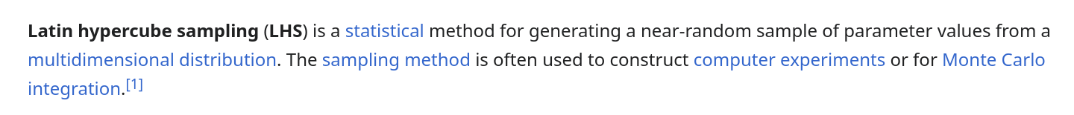
Latin Hypercube Sampling
To generate the random structures

Slide 29
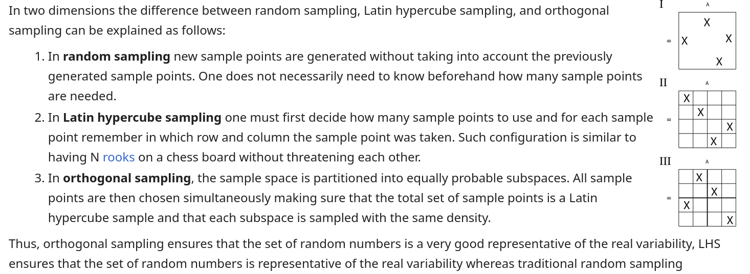
Latin Hypercube Sampling
To generate the random structures

Slide 30
Latin Hypercube Sampling
To generate the random structures

Slide 31
Latin Hypercube Sampling
To generate the random structures

Slide 32
06-05
Convergence test well and good
...but what about for more fine oscillations?
And what about smoothing, does it do anything?

Slide 33
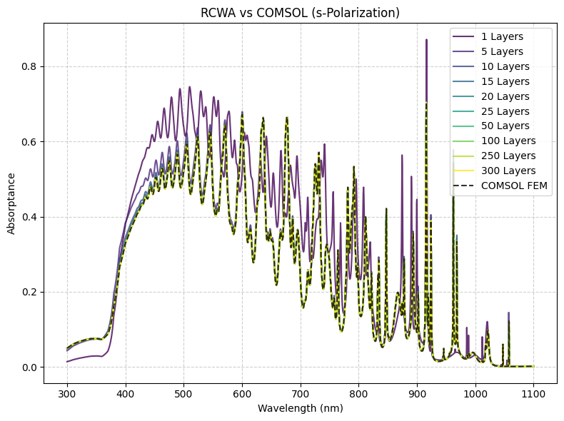

Slide 34
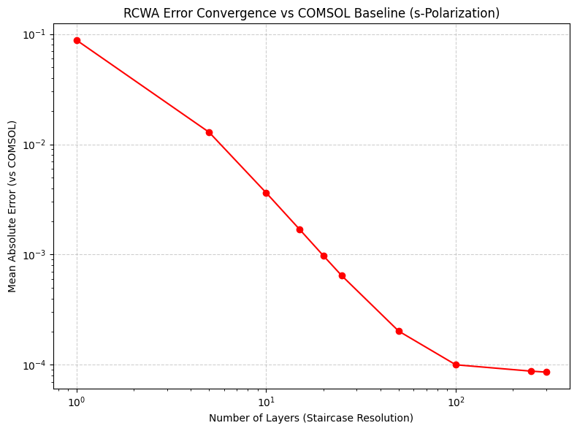

Slide 35
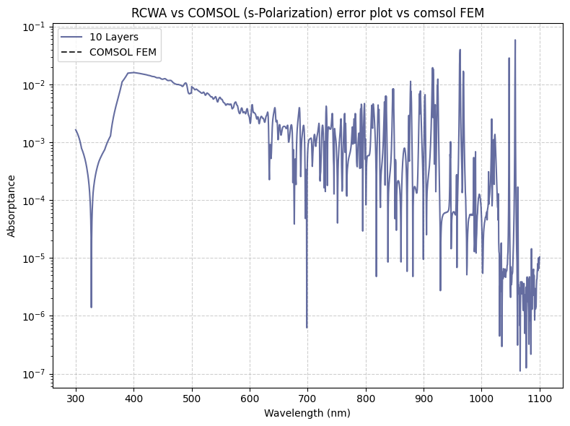

Slide 36
Are 10 layers still fine if there is a much smaller
oscillation included?

Slide 37
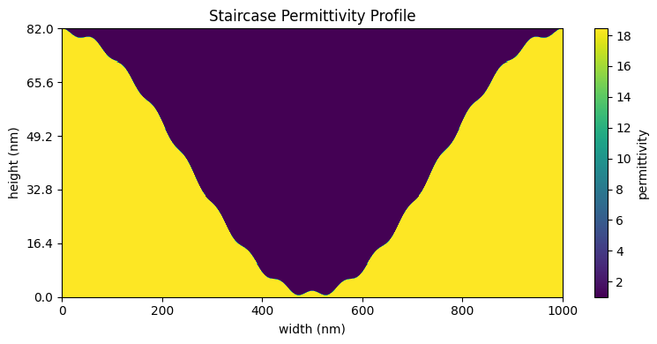

Slide 38


Slide 39
